Slide 1


Close Reading Detectives
East Greenwich School Department

Slide 2
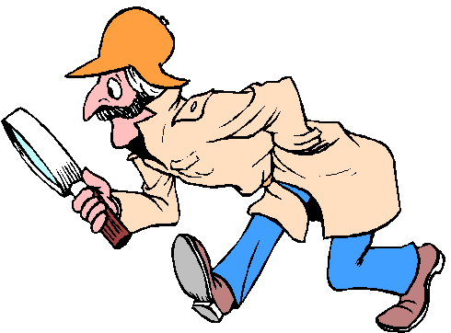
What do detectives do?
Look for evidence
Give the facts
Identify things that surprise them
Notice new information
Look for patterns
Ask questions especially how and why

Slide 3


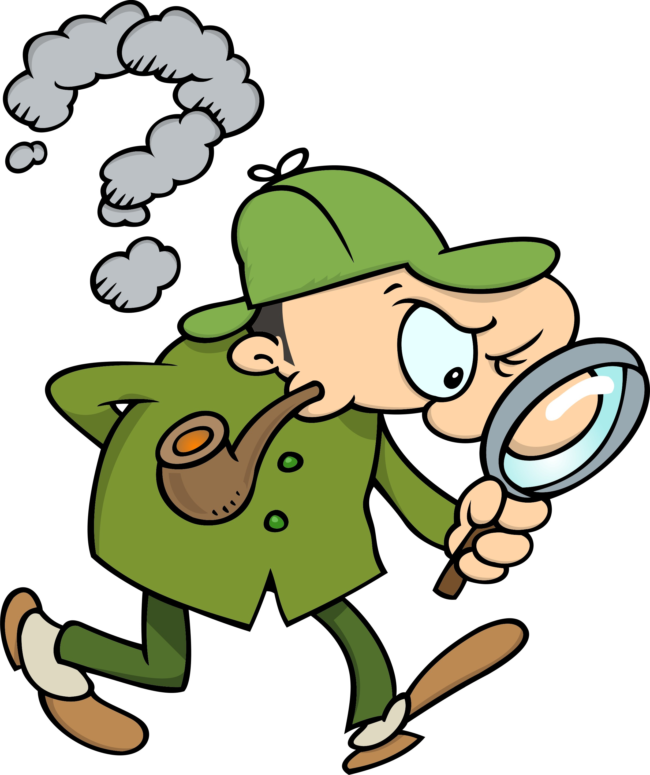

Tools of the trade
Close reader detectives use pencils, highlighters or sticky notes while the read so they can record the clues as they find them.

Slide 4

Every book has a skeleton inside.
It is up to the reader to discover it.
You are uncovering the meaning of what you are reading.
You are digging deeper into the text

Slide 5
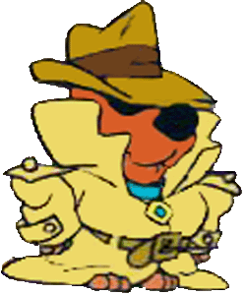
Repeated readings
You need to go over a reading multiple times to really understand it.

Slide 6
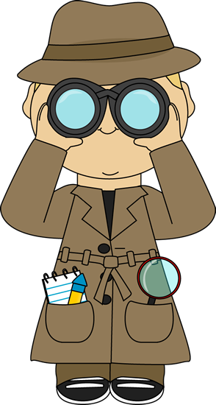
Annotation
Annotation is a note of any form made while reading text
Annotation slows down the reader in order to deepen understanding

Slide 7
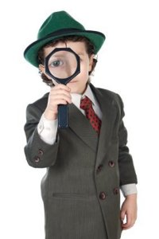
First Read
Number the paragraphs to find information easily.
Read the entire text once to get the flow of it.
Circle any unfamiliar words.
Use symbols to remind yourself of certain things:
  * - Something important
  ? – something you’re unsure of
  ! – Something that surprises you
  E- Evidence of text based question

Slide 8
How to Annotate a text
Left Margin | Right Margin
Summarize what you think the paragraph is about in 10 words or less. “Chunk” the paragraph – State what you believe to be the main idea. | Dig deeper! Describe the author’s purpose for writing the text (to inform, entertain, persuade). You may also want to comment on the author’s diction (word choice) and establish how it functions in the text.

