Slide 1
Vocabulary
2013-2014
Rakovic

Slide 2
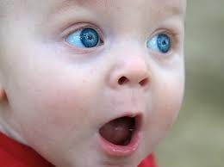
Amazement
Great surprise or wonder
Dorothy looked with amazement at the Munchins.
noun

Slide 3
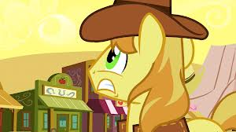
Anxiously
With fear
Natalie waited anxiously in the principal’s office.
adverb

Slide 4
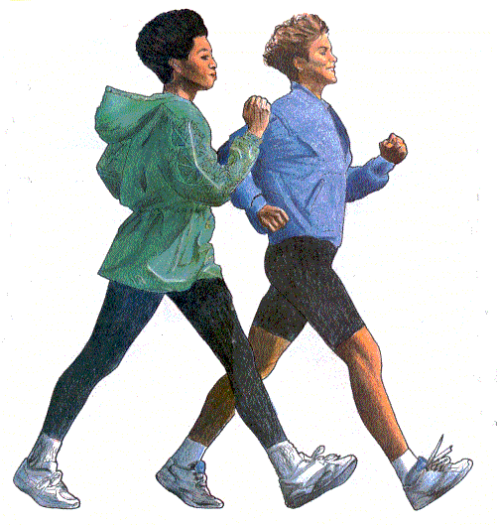
Brisk
quick
Dorothy took a brisk walk down the yellow brick road.
adjective

Slide 5
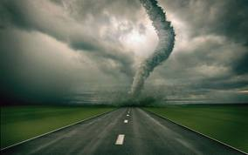
Cyclone
Tornado
A cyclone can cause a great deal of damage.
Noun

Slide 6
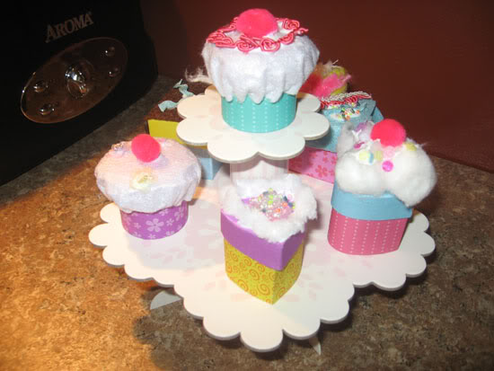
Dainty
Small and pretty
Ava drank from the dainty cup.
adjective

Slide 7
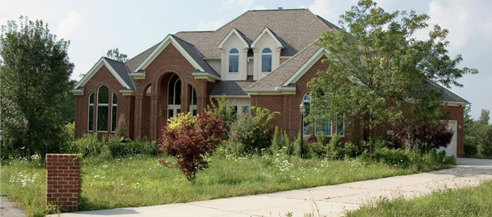
Dwelling
house
The houses of the Munchkins wer odd looking dwellings.
noun

Slide 8
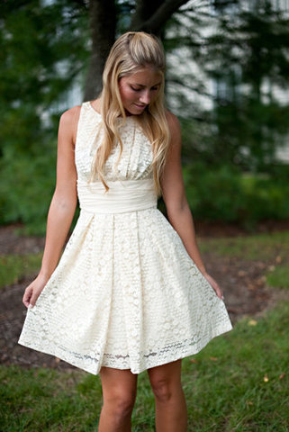
Frock
dress
Lauren wore a pretty frock.
noun

Slide 9
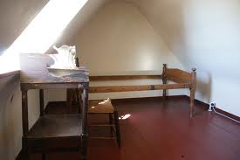
Garret
Attic
Dorothy’s house was so small it did not have a garret.
Noun

Slide 10
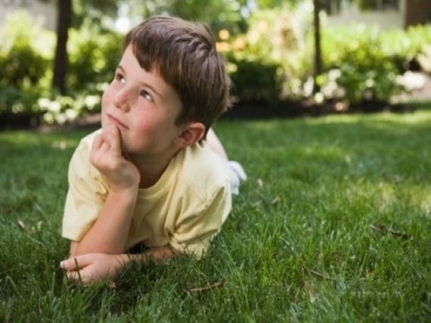
Gazed
Look for a long time
Dorothy gazed at the scarecrow.
verb

Slide 11
Gingham
Check pattern cloth
Dorothy wore a dress made of gingham.
noun

Slide 12
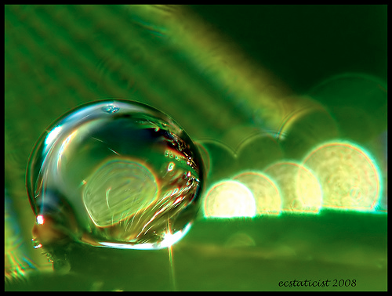
Glistened
sparkled
The good fairy glistened .
Verb

Slide 13
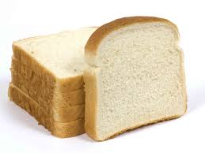
Ordinary
Normal, everyday, not special
Today was just an ordinary day .
adjective

Slide 14
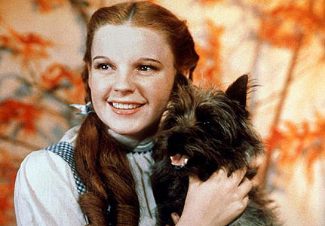
Orphan
A child whose parents are not alive
Dorothy was an orphan and lived with her aunt and uncle.
Noun

Slide 15
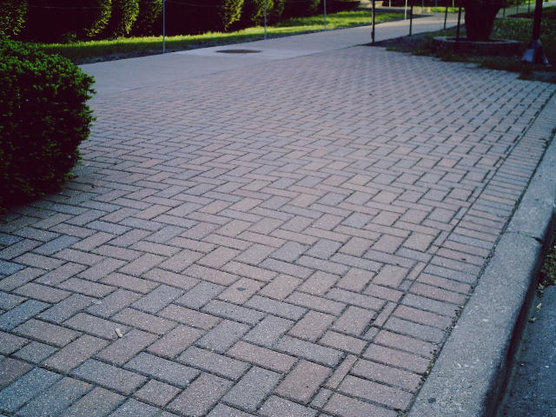
Paved
Covered
Dorothy needed to follow the road paved with yellow bricks
Verb

Slide 16
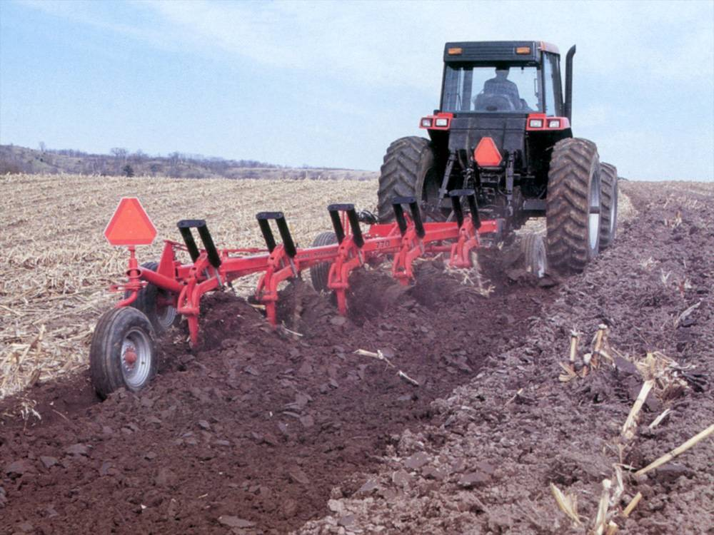
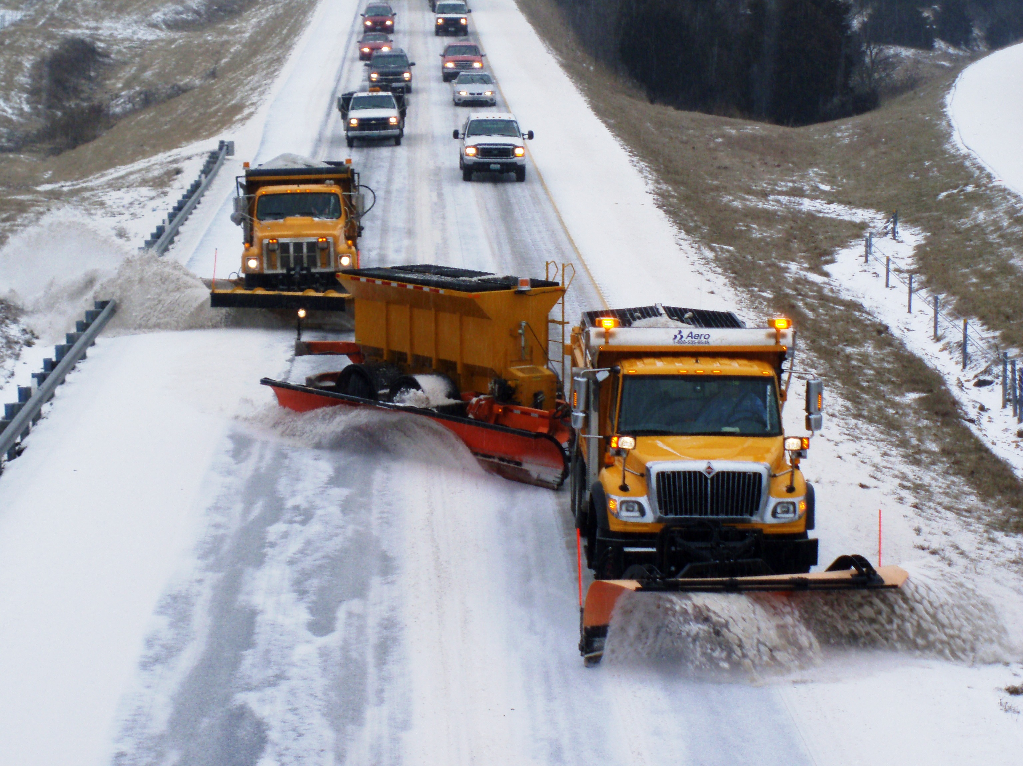
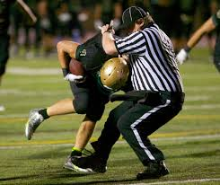
Plow
Push
Uncle Henry plowed the field before he planted the crops.
Verb

Slide 17
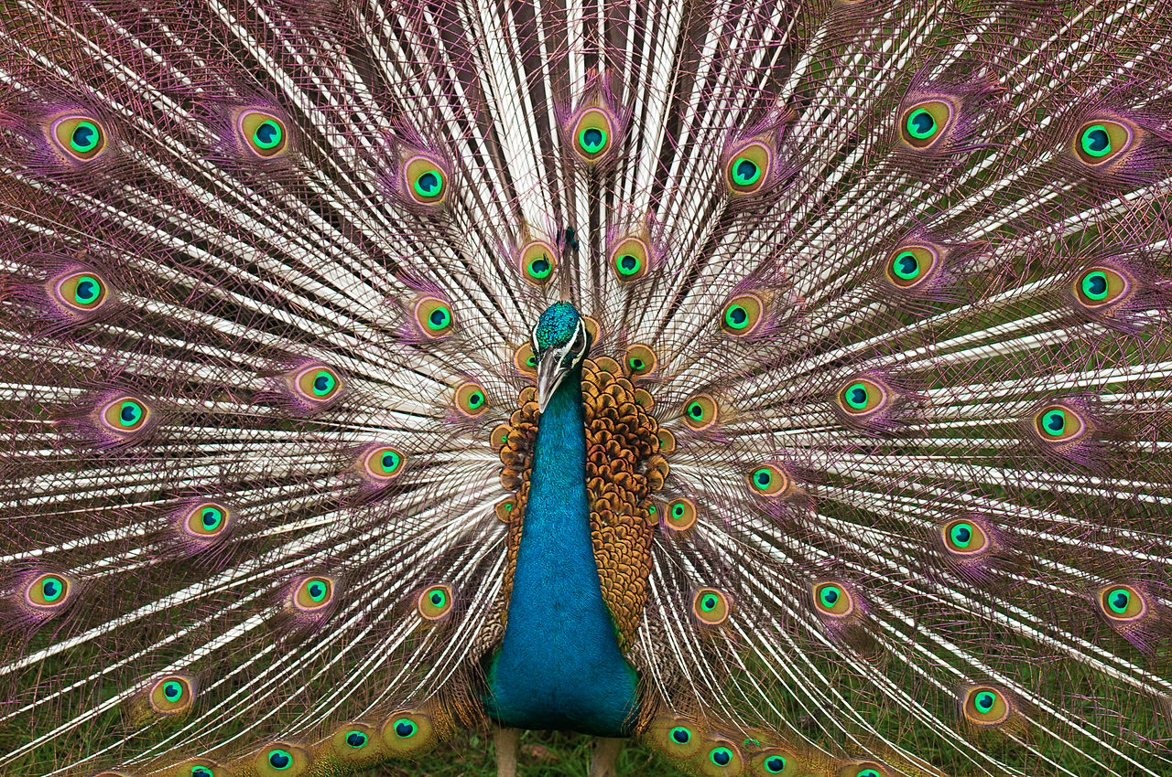
Plumage
feather
The birds had beautiful plumage .
Noun

Slide 18
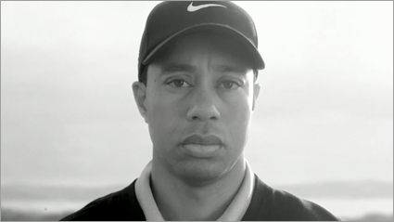
Soberly
Seriously
Toto walked soberly by Dorthy’s side
Adverb

Slide 19
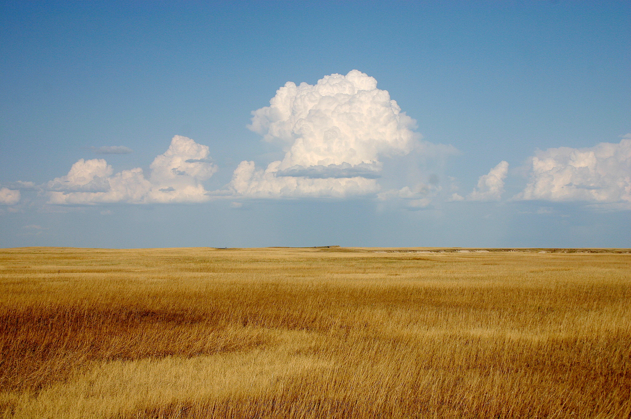
Prairie
A large open area of flat or rolling land that is covered with grass and has very few trees or none at all
Dorothy lived on a prairie.
Noun

Slide 20
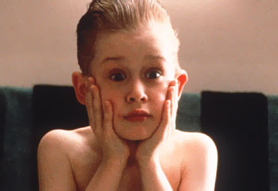
Startled
Surprise, Frightened
Dorothy was startled when she looked outside the door.
Verb

Slide 21
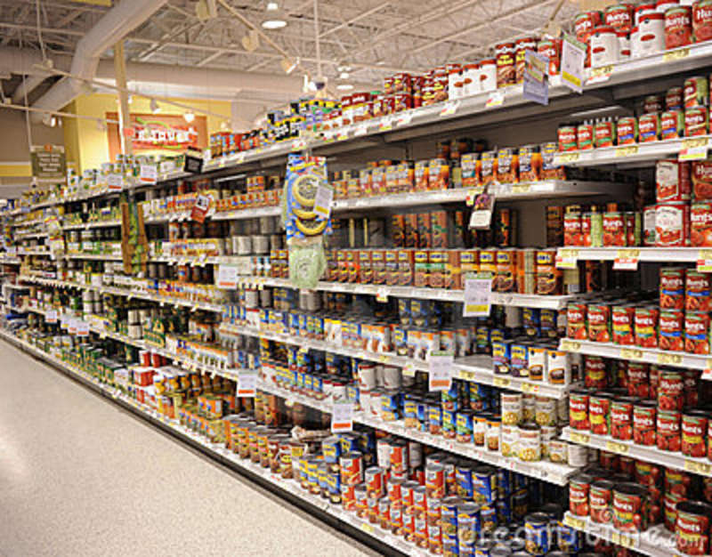
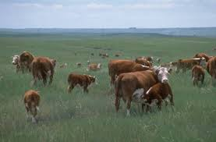
Stock
Supplies
Farm animals
Uncle Henry checked the stock when the storm was coming .
Noun

Slide 22
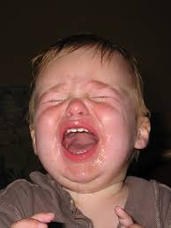
Wail
Cry
The baby wailed when someone took his toy.
Verb

Slide 23
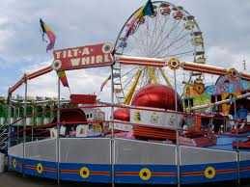
Whirl
Move in a circle
The cyclone whirled around the field.
Verb

